Slide 1
A PRODUCT IDEA · 2026
Cross-Cultural
Meme Translator
Because "nobody likes you" sounds like flirting in Chinese.
PRESENTED BY YOU
01 / 07
Notes:
Hi everyone. Today I want to show you a fun product I made. It is called Cross-Cultural Meme Translator. The idea is simple: we all use memes online, but people from different countries do not understand each other's memes. So I built a tool to fix that. Let me explain.

Slide 2
THE PROBLEM
Fun is more
important than useful.
We always do serious cultural communication. Like explaining the history of Mid-Autumn Festival.
But even Chinese people do not care about that. Why would foreigners?
SERIOUS TALK
"The Mid-Autumn Festival dates back to the Tang Dynasty..."
→ Everyone falls asleep
CROSS-CULTURAL MEME TRANSLATOR
02 / 07
Notes:
So here is the problem. We always try to teach foreign people about our culture in a very serious way. Like, "let me tell you the 3000-year history of Mid-Autumn Festival." But honestly, even I do not want to hear that. And foreign people? They definitely do not care. I think being fun is more important than being useful. If it is not fun, no one will listen.

Slide 3
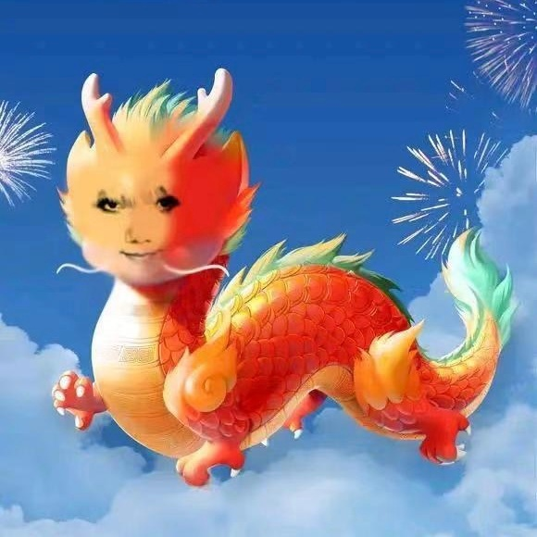
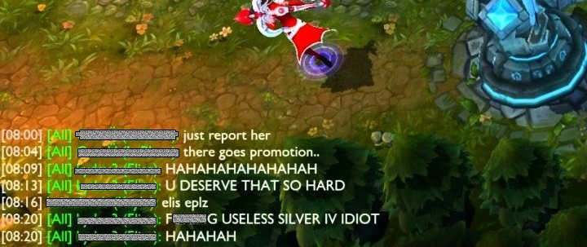
THE CULTURE GAP
Same feeling, totally different words
IN CHINA
IN THE WEST
Saying "you are so bold" is boring.
Sending a dragon meme says it all.
Their worst insult is "nobody likes you." In Chinese culture, that sounds like flirting.
CROSS-CULTURAL MEME TRANSLATOR
03 / 07
Notes:
And this gap is everywhere. In China, if you want to say "you are so bold," you do not just say it. You send a dragon meme. Everyone gets it. In the West, it is the same. Like when you play League of Legends and people argue. The worst thing they say is "nobody likes you." But to Chinese people, that sounds really gentle, almost like flirting. We do not feel insulted at all. So the problem is not language, it is memes.

Slide 4
WHY IT FAILS
Translation apps translate words, not vibes
NORMAL TRANSLATOR
MEME TRANSLATOR
Input: "the class is so boring"
Input: "the class is so boring"
"这节课很无聊"
"这课真是闹麻了"
Correct. But boring. Nobody talks like this.
Now that is how people actually talk online.
CROSS-CULTURAL MEME TRANSLATOR
04 / 07
Notes:
So you might ask, we already have Google Translate, right? Why do we need this? Because normal translators only translate words. They give you the correct meaning, but it sounds like a textbook. No one talks like that online. For example, "the class is so boring." A normal translator says "这节课很无聊." Correct, but boring. My tool says "这课真是闹麻了." That is how real Chinese people talk on the internet. That is the difference.

Slide 5
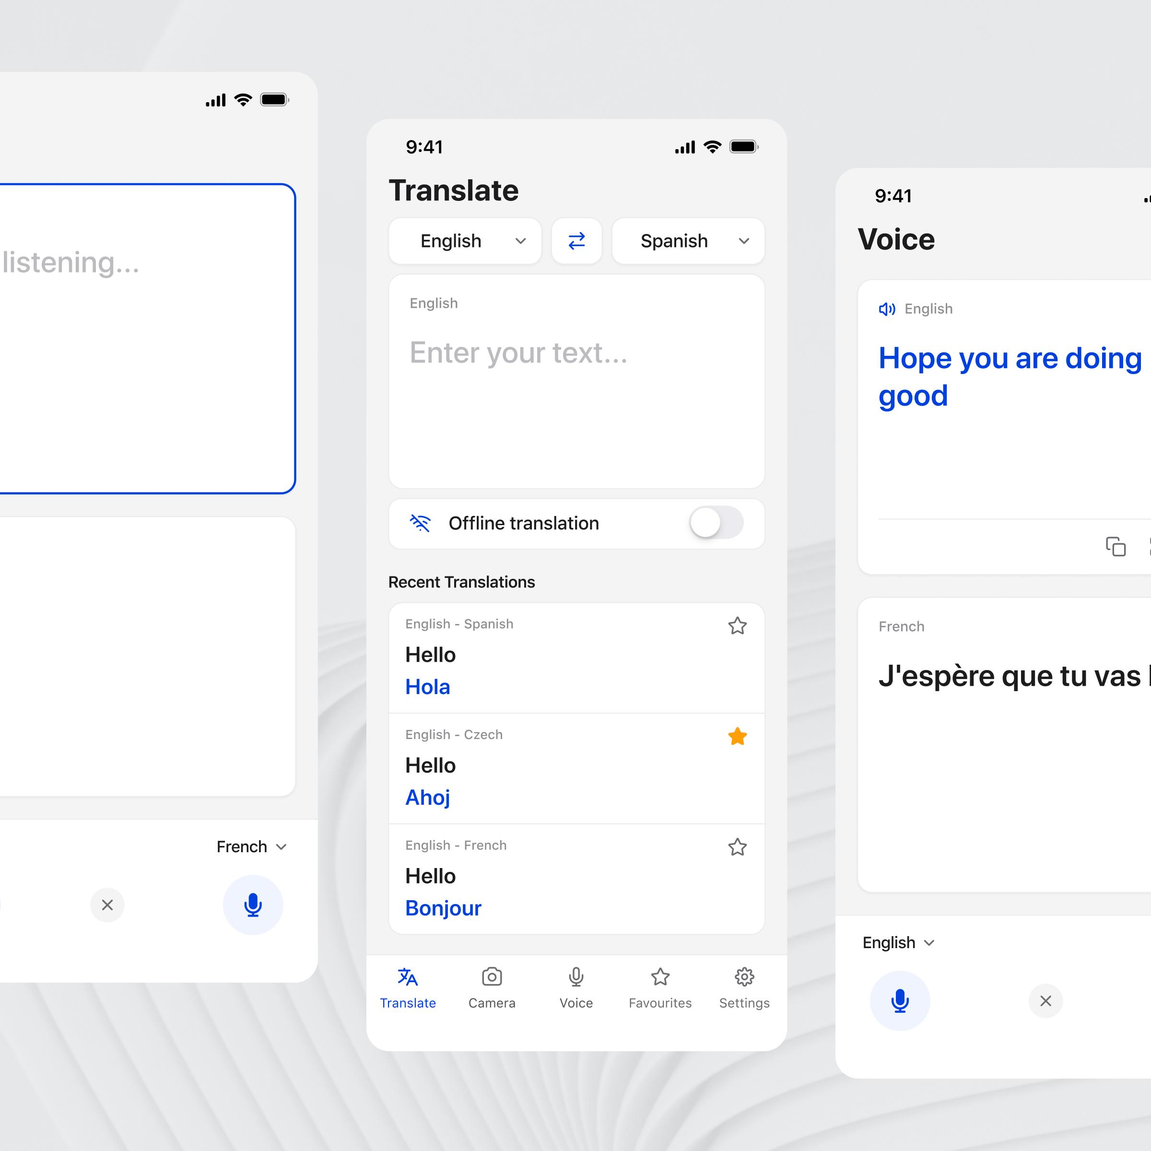
THE PRODUCT
It works both ways.
English → Chinese meme: Type normal English, get the way Chinese people actually say it online.
Chinese → English meme: Type Chinese slang, get the English version that fits Western internet culture.
TRY IT NOW
UI concept · Translator interface
CROSS-CULTURAL MEME TRANSLATOR
05 / 07
Notes:
So here is my product. It works both ways. First, English to Chinese meme. You type normal English, and it gives you the Chinese internet slang version. Like how real Chinese people talk online. Second, Chinese to English meme. You type Chinese slang, and it gives you the English version that Western people actually use. Not the textbook translation, but the real internet vibe. So now foreign gamers can finally understand what we are saying, and we can understand them too.

Slide 6
LIVE DEMO
See it in action
ENGLISH → CHINESE MEME
CHINESE → ENGLISH MEME
"the class is so boring"
"你行你上啊"
"这课真是闹麻了"
"ok boomer, you do it then"
"the class is so good"
"什么档次跟我用一样的"
"这个课真尼玛有点意思啊啊啊"
"bro really thinks he's the main character"
CROSS-CULTURAL MEME TRANSLATOR
06 / 07
Notes:
Let me show you some examples. English to Chinese: "the class is so boring" becomes "这课真是闹麻了." That is real internet slang. "The class is so good" becomes "这个课真尼玛有点意思啊啊啊." Very excited, very online. Now Chinese to English: "你行你上啊" becomes "ok boomer, you do it then." And "什么档次跟我用一样的" becomes "bro really thinks he is the main character." These are things Western people actually say online. Not textbook stuff. Thank you.

Slide 7

THE VISION
Let Chinese and foreign
netizens finally understand
each other's jokes.
Because fun is the universal language. Not textbooks.
Thank you.
CROSS-CULTURAL MEME TRANSLATOR
07 / 07
Notes:
So that is my product. The vision is simple. I want Chinese people and foreign people to finally understand each other's jokes. Because being fun is the real universal language. Not textbooks, not serious history lessons. If we can laugh at the same memes, we can understand each other better. Thank you for listening. Any questions?

